Slide 1



Slide 2

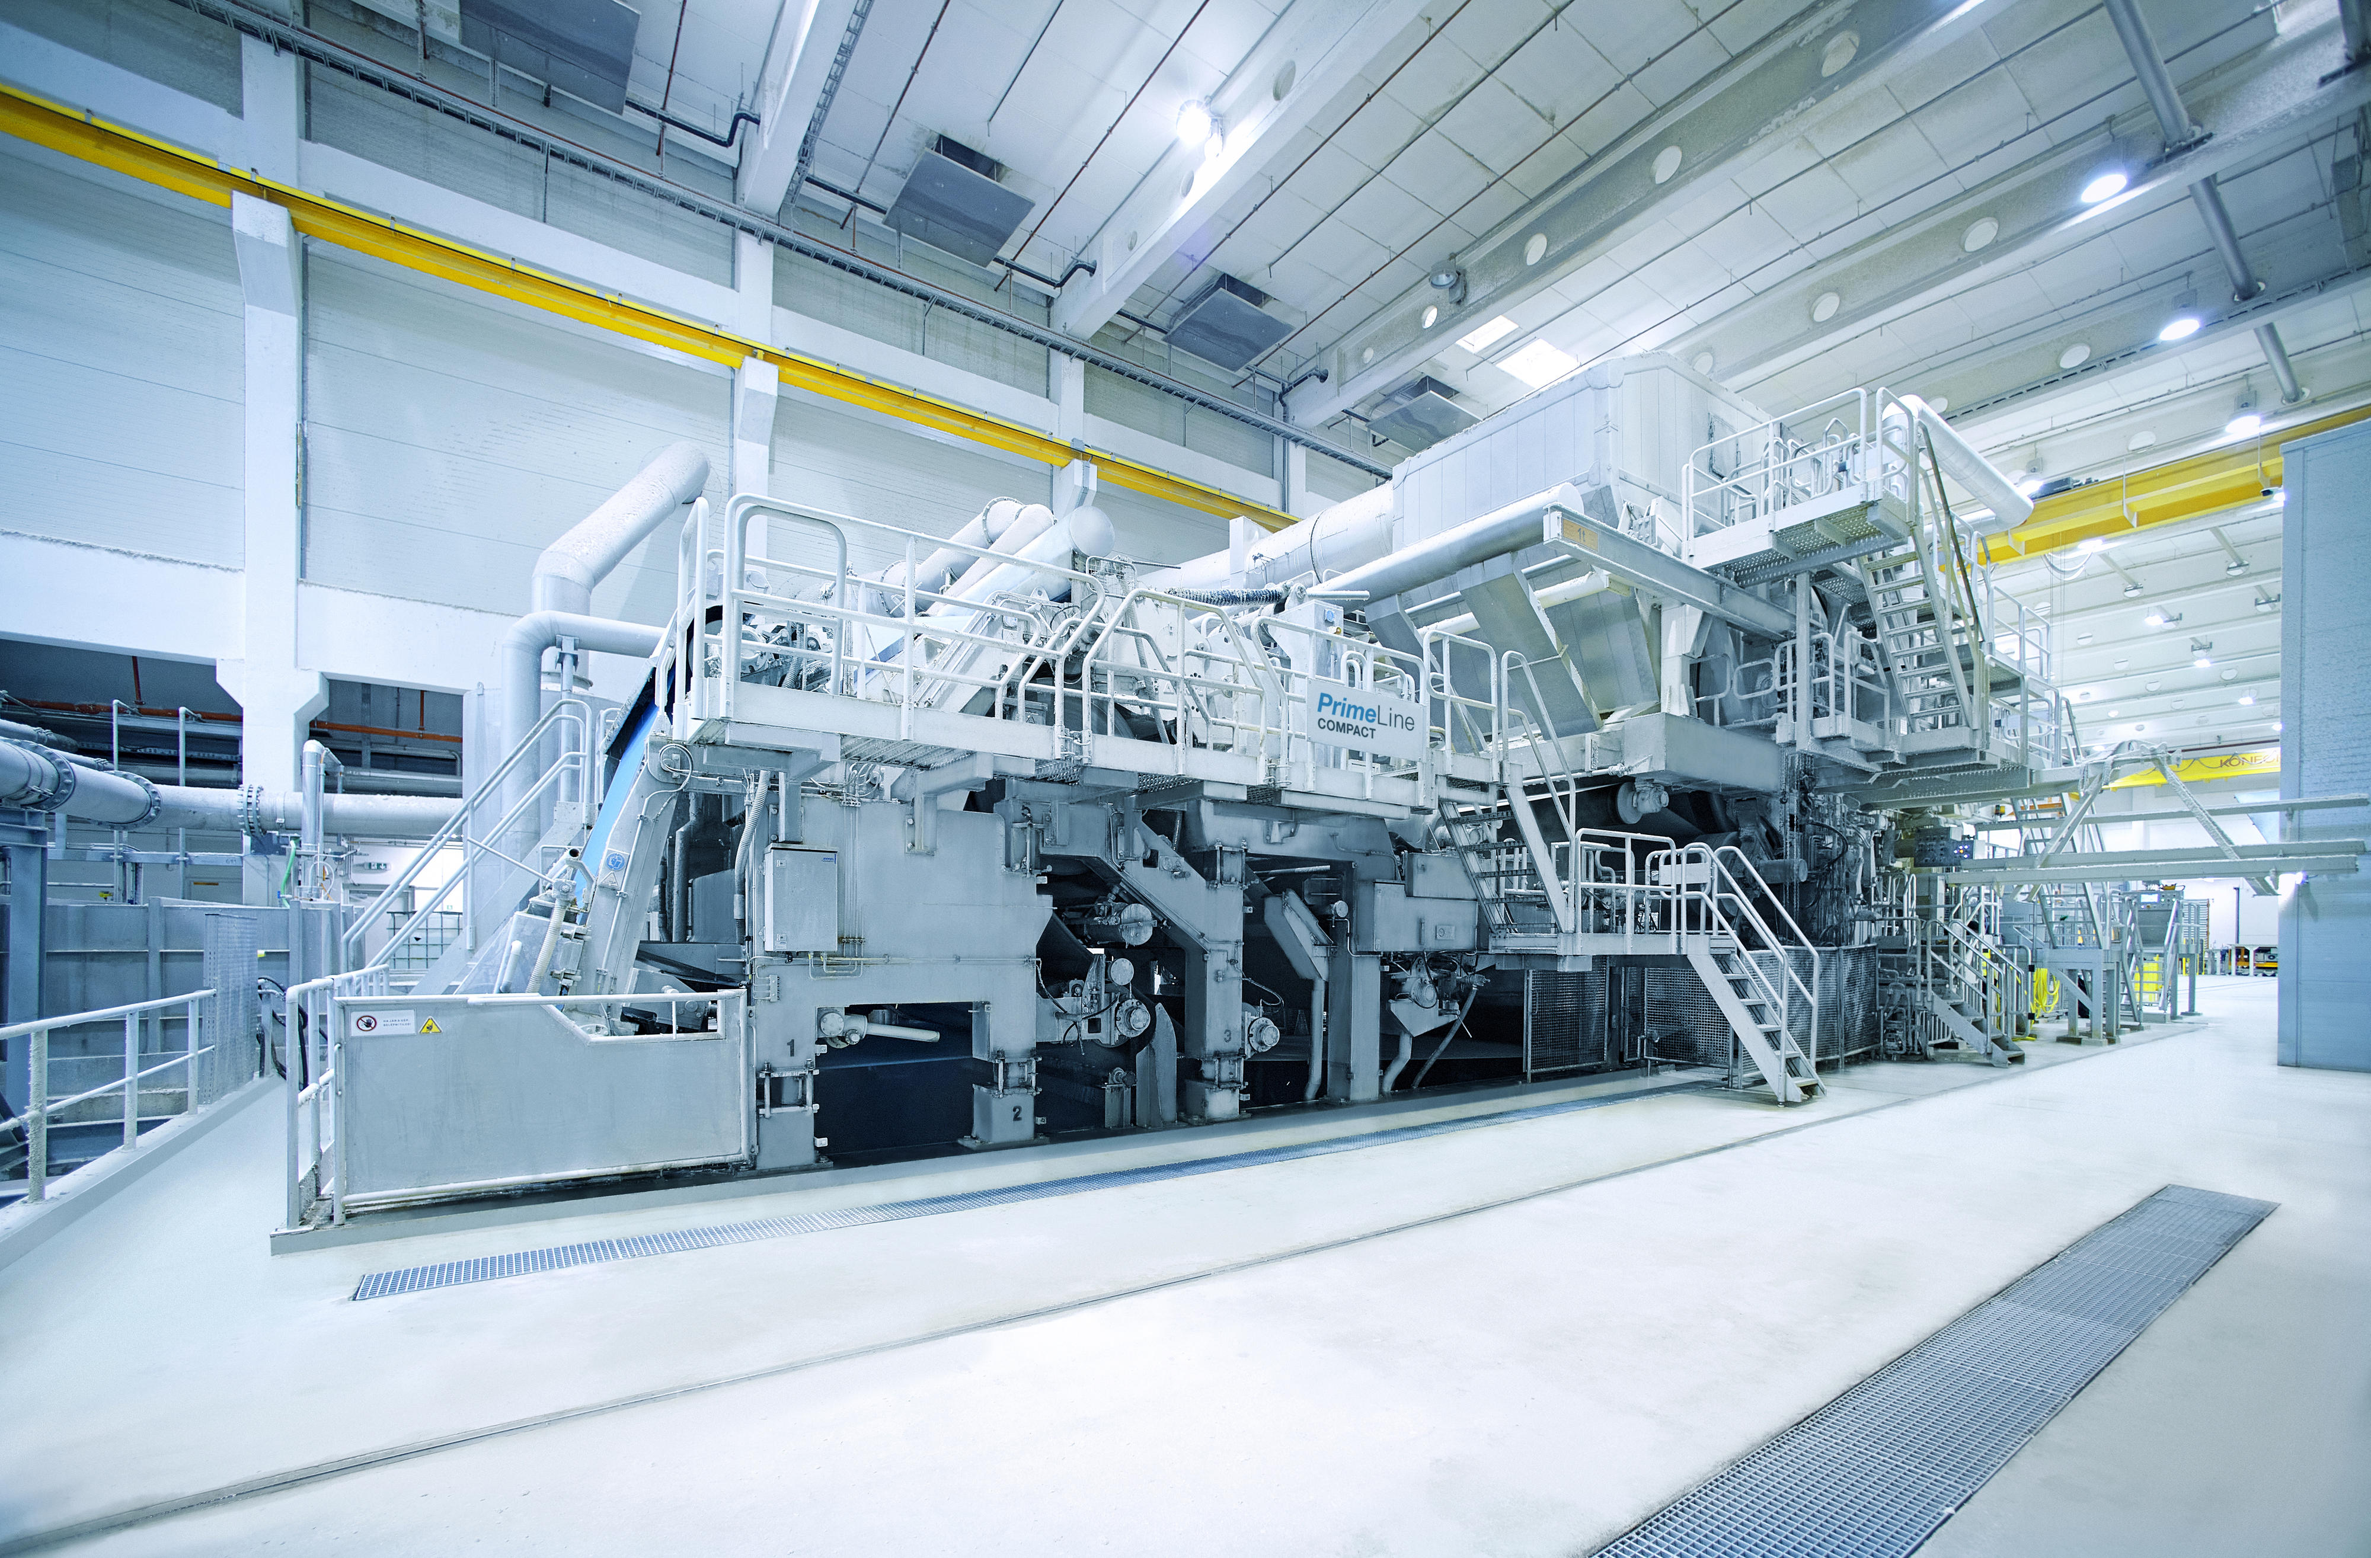









MEET THE TEAM
Kaushil Mangaroliya
Tanmay Itkelwar
Jahnani Shivkumar
Robin Shukla
Data Science Researcher leveraging in-depth skills in Machine Learning, Deep Learning, Python, and SQL along with business domain knowledge. Determined to deliver data-driven decisions helping businesses grow exponentially. Also an avid researcher, having 3 research papers in ML and DL with over 28 citations behind me always looking for my next adventure
Imagine a skilled software developer who has now turned into a savvy data analyst and is now on a mission to combine the best of both worlds to become a master data engineer! Alongside data I love nature and I’ve been on 6 different hikes in the Himalayas
Passionate data professional skilled in Python, R, SQL, and analytics. A desire to drive innovative solutions and contribute to organizational success. Proven in quantitative analysis, project management, and optimizing workflows for strategic impact. Passionate singer and a selenophile.
Marketing maven and data visualization virtuoso—my name's Robin Shukla. I’m in the business of transforming data into compelling marketing narratives and actionable insights.
On the side an Ex Soccer player and a die-hard Cr7 fan!!

Slide 3
Problem Statement
To perform a complete a geographic assessment to identify locations for up to three new tissue mills and to create an estimate on potential logistics costs from your mill locations to the Top 20 major metropolitan areas in the Continental US.

Slide 4






Market
Analysis
Logistic
Cost
Clustering
Data Processing
Demand
Dashboard
Final
Locations

Slide 5
Market
Analysis

Slide 6
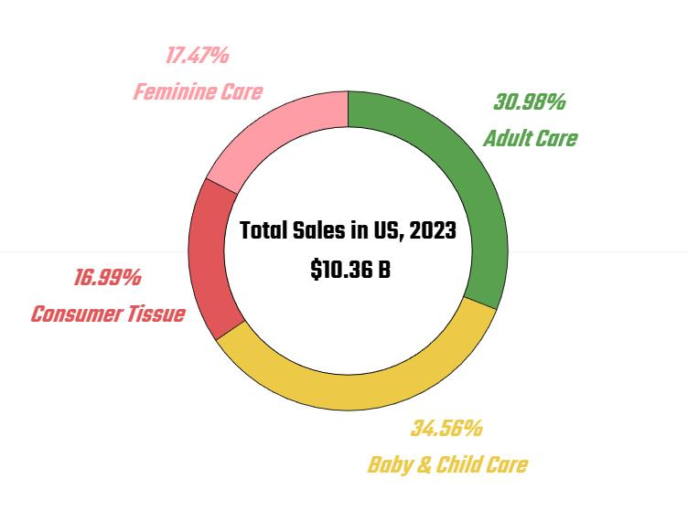
Market
Analysis
Market Analysis
In 2012, Kimberly-Clark closed its last pulp mill in Texas, transitioning to sourcing pulp from external suppliers.
The closure of pulp mills has broader implications for the availability of green paper products.
Category | Market Share | Products | Competitors
Diapers | 30% | Huggies | Procter & Gamble (P&G)
Feminine Care | 15–20% | Kotex | SC Johnson
Adult Incontinence | 35% | Depend, Poise | Essity
Facial Tissue | 40% | Kleenex | Unicharm
Paper Towels & Toilet | 25–30% | Scott, Cottonelle, Viva | Georgia-Pacific

Slide 7
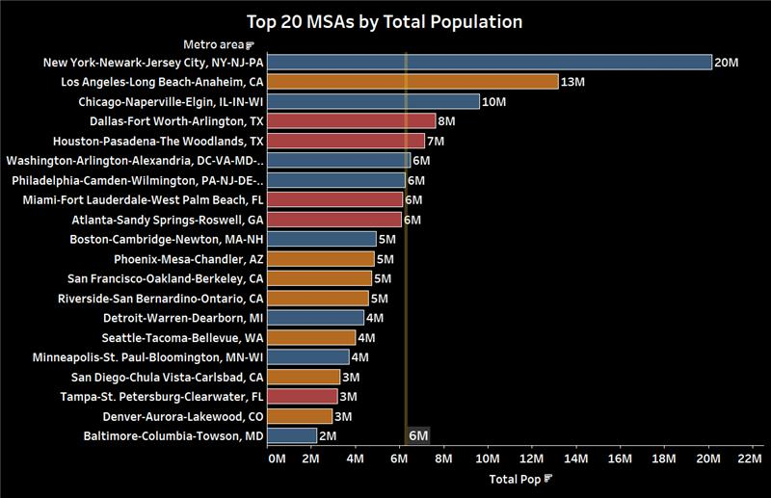
Top 20 Metropolitan Areas
Market
Analysis

Slide 8
Market
Analysis
Logistic
Cost
Clustering
Data Processing
Demand
Dashboard
Final
Locations

Slide 9
Data Processing

Slide 10
Data Processing
Data Processing
Aggregation Steps:
Started with Census Tract-level data
Mapped to unique counties
Merged counties into corresponding Top 20 metro areas
Enrichment:
Integrated latitude and longitude for geographic analysis
Added population density and demand estimates per MSA

Slide 11
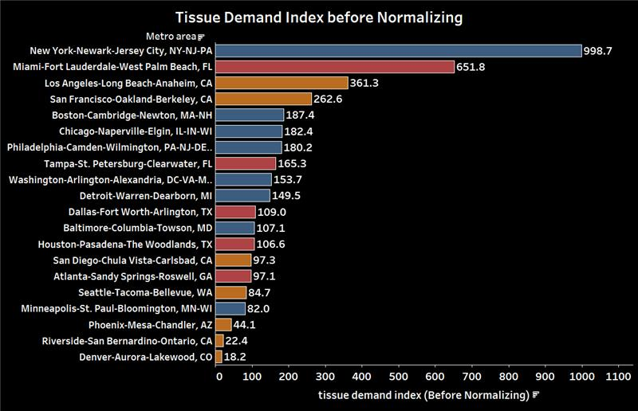
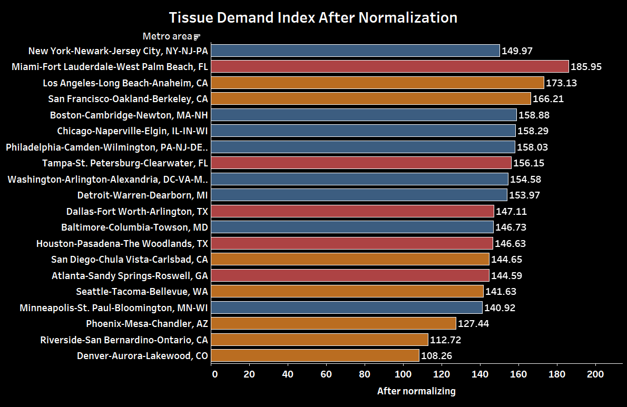
KPIs and Feature Engineering
Data Processing
Diapers Demand Index (DDI) | 100 x (Population aged 0–5/total population)/ National avg (5.55%)
Adult Care Demand Index (ADI) | 100 x (Population aged 65+/total population)/ National avg (16.83%)
Feminine Care Demand Index (FDI) | 100 x (Female population aged 15 – 49 total population)/ National avg (22.80%)
Tissue Demand Index (TDI) | 50 x Log(population density / National Average(93.8))
Weighted Demand Index (WDI) | (0.34 x DDI) + (0.17 x ADI) + (0.16 x FDI) + (0.30 x TDI)

Slide 12
Market
Analysis
Logistic
Cost
Clustering
Data Processing
Demand
Dashboard
Final
Locations

Slide 13
Clustering

Slide 14
Clustering Using K-Means
Clustering
Objective:
To identify regional groupings based on geographic proximity
Approach:
Applied K-Means Clustering on latitude & longitude
Formed 3 regional clusters
Result:
Clear identification of regional hubs to optimize logistics

Slide 15
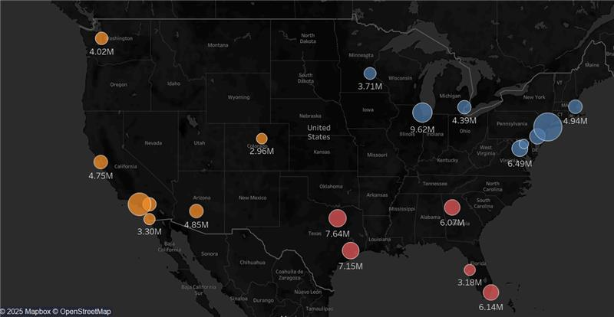
Clustering

Slide 16
Market
Analysis
Logistic
Cost
Clustering
Data Processing
Demand
Dashboard
Final
Locations

Slide 17
Demand
Dashboard

Slide 18
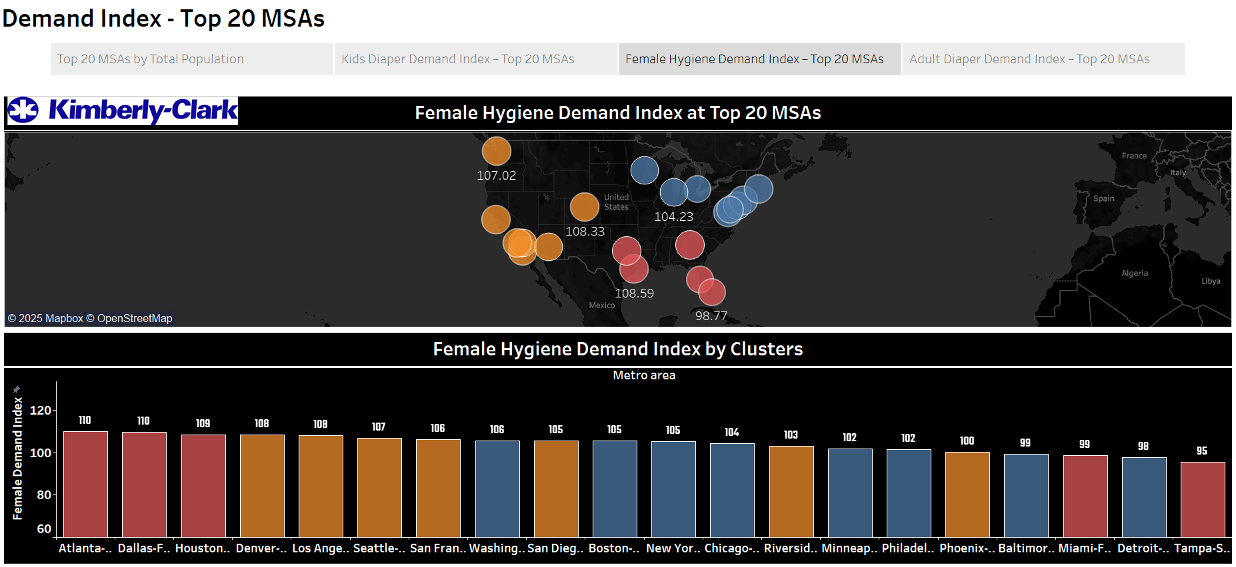
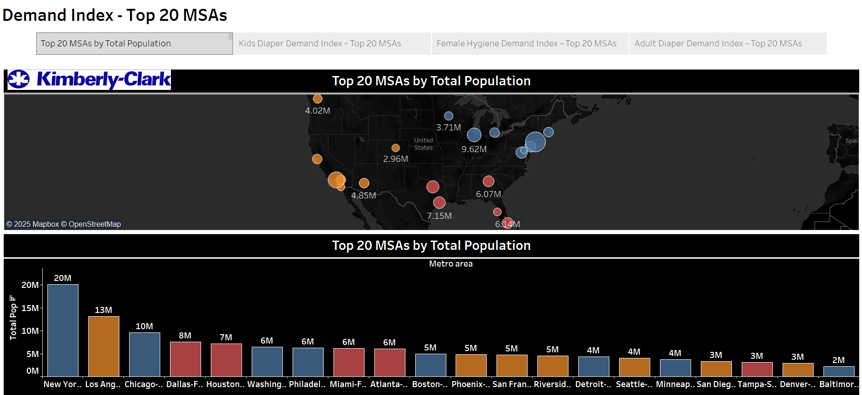
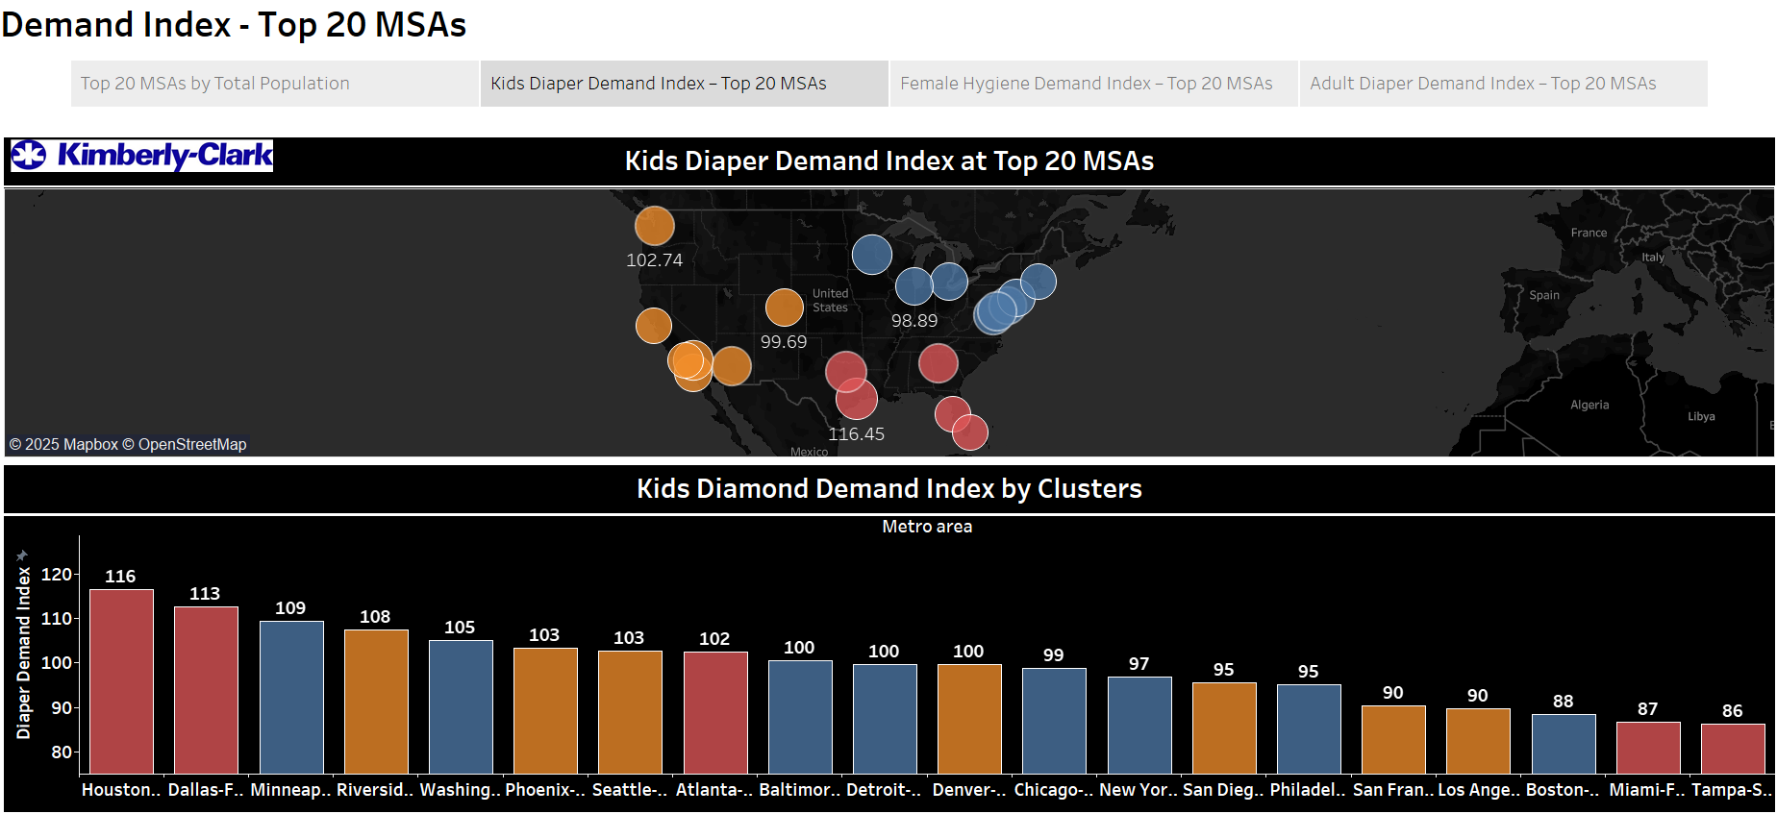
Demand Dashboard
Demand
Dashboard

Slide 19
Market
Analysis
Logistic
Cost
Clustering
Data Processing
Demand
Dashboard
Final
Locations

Slide 20
Logistic
Cost

Slide 21
Logistics Cost Estimation
Logistic
Cost
Methodology:
Used Google Maps API for distance estimates
Calculated cost based on:
Distance (miles)
Number of truckloads (demand-based)
Per-mile transport cost

Slide 22
Logistic Cost Formula
Logistic
Cost
Demand = Population × MS x CPC / Truck Capacity
Total Cost = Demand × [ ( Dist × Rate ) × ( 1 + Misc ) + 60 + 25 ]
Where:
MS = Average Market Share = 32.7%
CPC = Consumption per-capita = 25 lbs
Truck Capacity = 25,000 Lbs
Dist = Distance(in miles)
Rate = Rate of Freight = $2.75/mile
Misc = Miscellaneous (fuel surcharge, tolls, etc.) = 15%
$60 = Loading & Unloading
$25 = Admin Fees (Manager Oversight)

Slide 23
Market
Analysis
Logistic
Cost
Clustering
Data Processing
Demand
Dashboard
Final
Locations

Slide 24
Final
Locations

Slide 25
Factors for Selecting Mill Locations
Final
Locations
Proximity to Major Demand Centers
Transportation Infrastructure (Highways, Railways)
Water Body
Utility Costs (Electricity, Other Overheads)
Labor Market Costs (Skilled, Unskilled)
Industrial Zone
Real Estate Cost
Tax Incentives & State Policies

Slide 26
5 Locations
 | FROM CLUSTERING | INDUSTRY STANDPOINT
❌ | Clallam County, Washington | Serving Just 1 Metropolitan Area WA – Small market, Isolated
❌ | Mobile, Alabama | Already Present – Mobile Paper Mill
✅ | Palm Beach County, Florida | Can Serve 2 Metropolitan Areas
🟧 | Buttler County, Pennsylvania Next Best – Go to Great Lake Geographic Corridor i.e. Wisconsin | Already Present – Chester Paper Mill PA - Best Freight Rate, Delaware River, All Major Truck Companies
🟧 | Nye County, Nevada Next Best – Go to next nearest State i.e. Utah | No Proper Water Source CA mill also got closed due to high overheads – Utility Bill, Freight Rate, Gas, Tax Rate
Notes:
Eliminated Locations
Pennsylvania – Chester Mill Covers NorthEast+Mid-Atlantic ( Freight Rate is Low, Truck Availability, & Industry Heavy State)
Nevada – Less Water Bodies, Desert, High Temperatures
Washington – Very Isolated, Seres just 1 Metro, Opportunity Cost
Picked Locations
Utah – Good Connectivity, Great Salt Lake, Skilled/Unskilled Labor, Low Overheads
Wisconsin – Entry in Great Lakes Geographic Region, Chicago-Minneapolis-Detroit, Huge Water Bodies

Slide 27
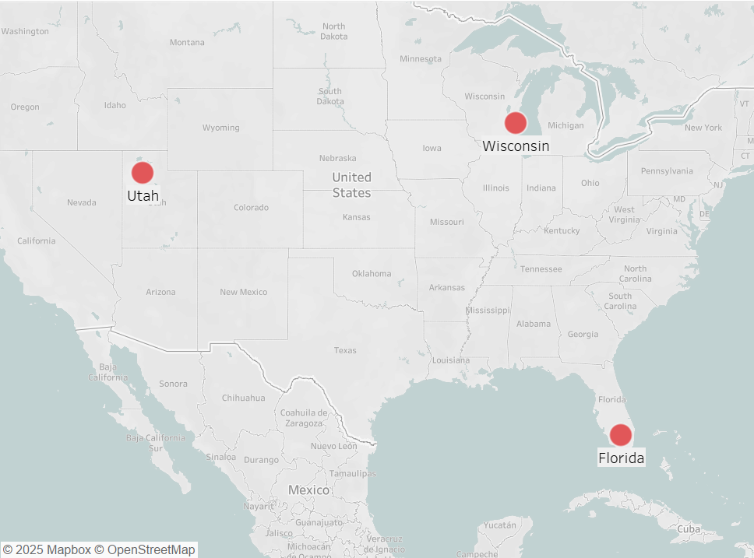
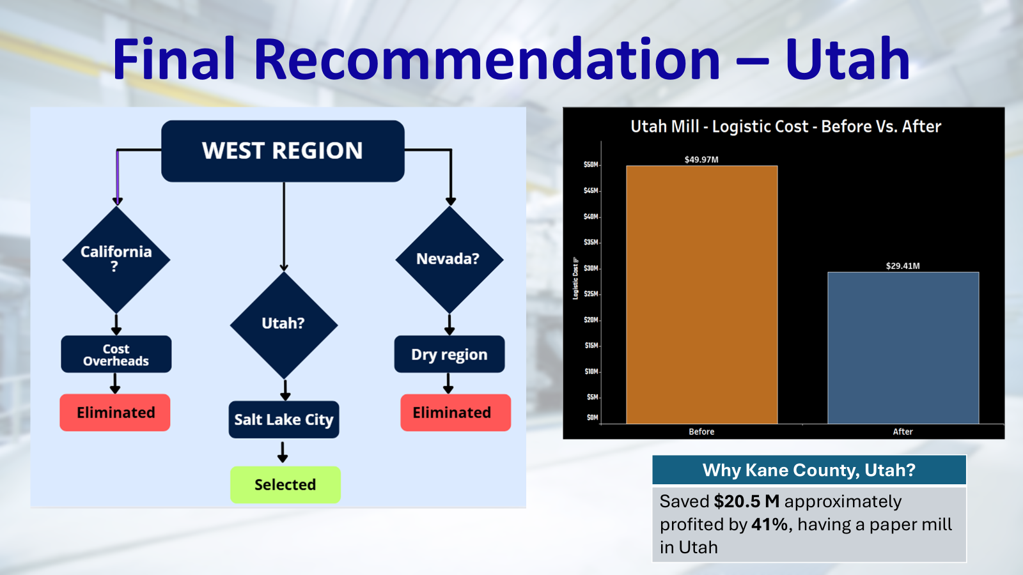

Slide 28
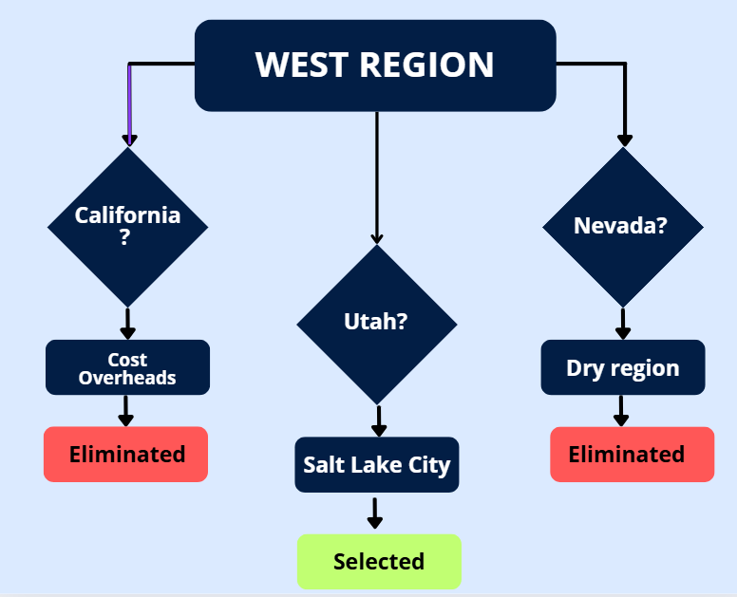
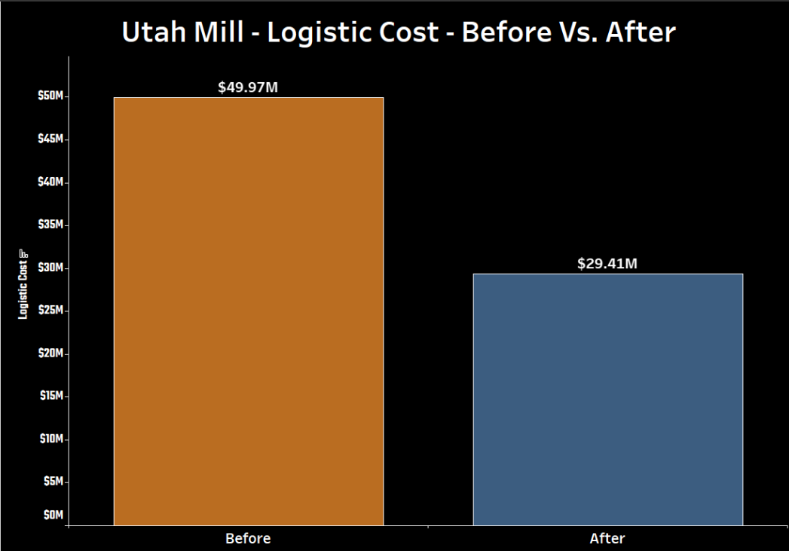
Final Recommendation – Utah
Why Kane County, Utah?
Saved $20.5 M approximately profited by 41%, having a paper mill in Utah

Slide 29
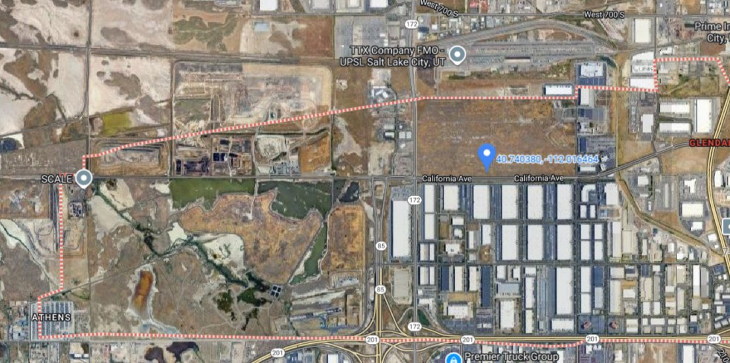

Slide 30
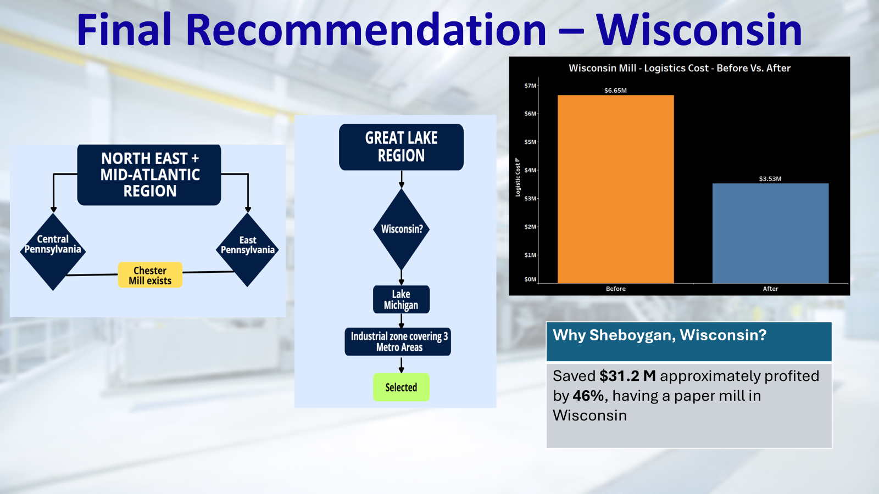

Slide 31
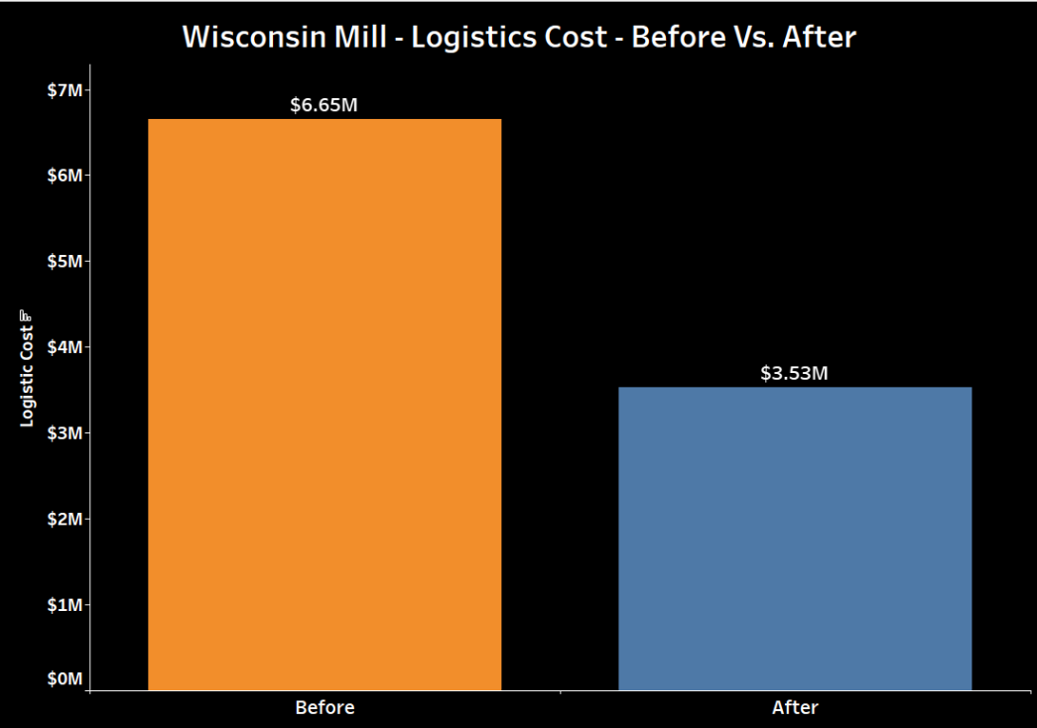
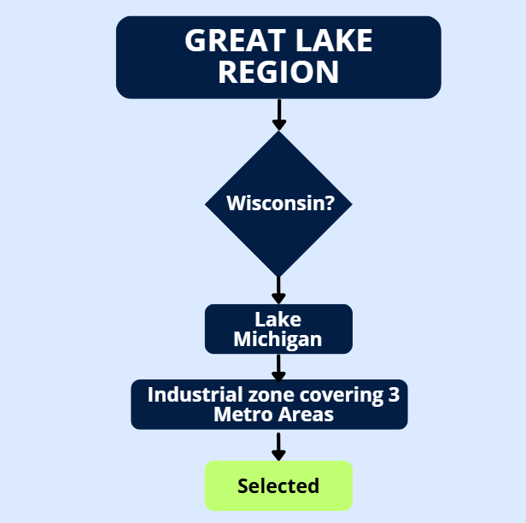
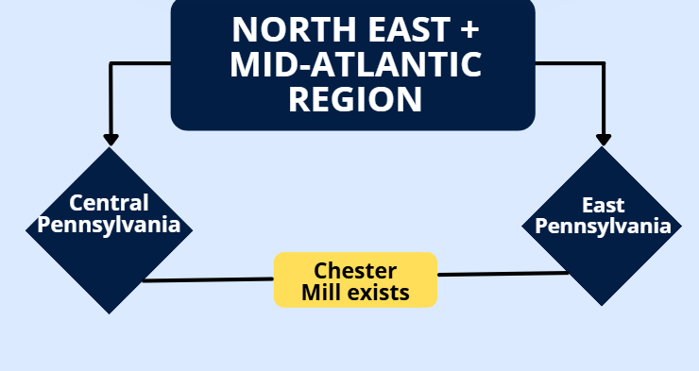
Final Recommendation – Wisconsin
Why Sheboygan, Wisconsin?
Saved $31.2 M approximately profited by 46%, having a paper mill in Wisconsin

Slide 32
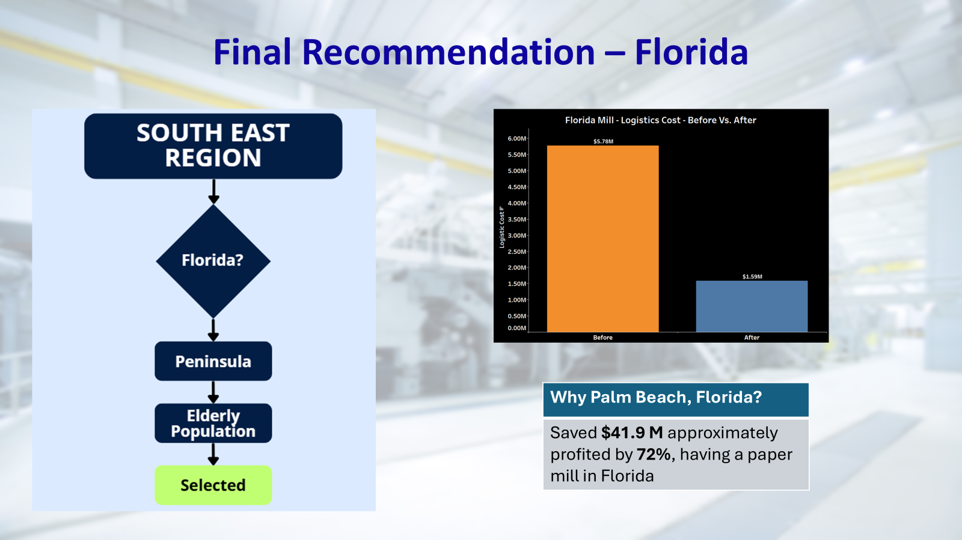

Slide 33
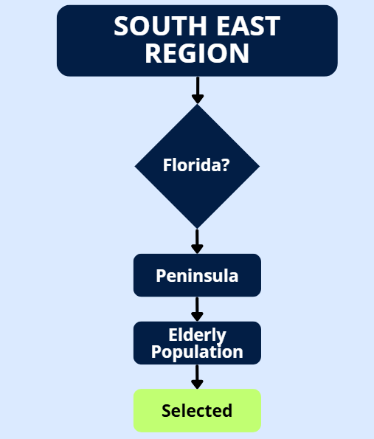
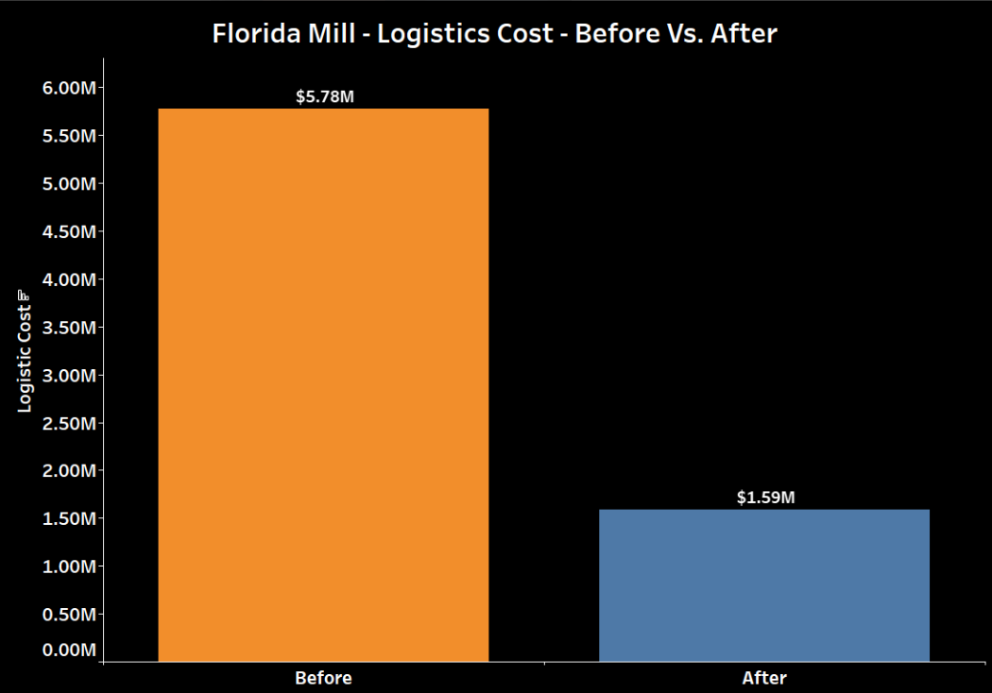
Final Recommendation – Florida
Why Palm Beach, Florida?
Saved $41.9 M approximately profited by 72%, having a paper mill in Florida
$4.19

Slide 34
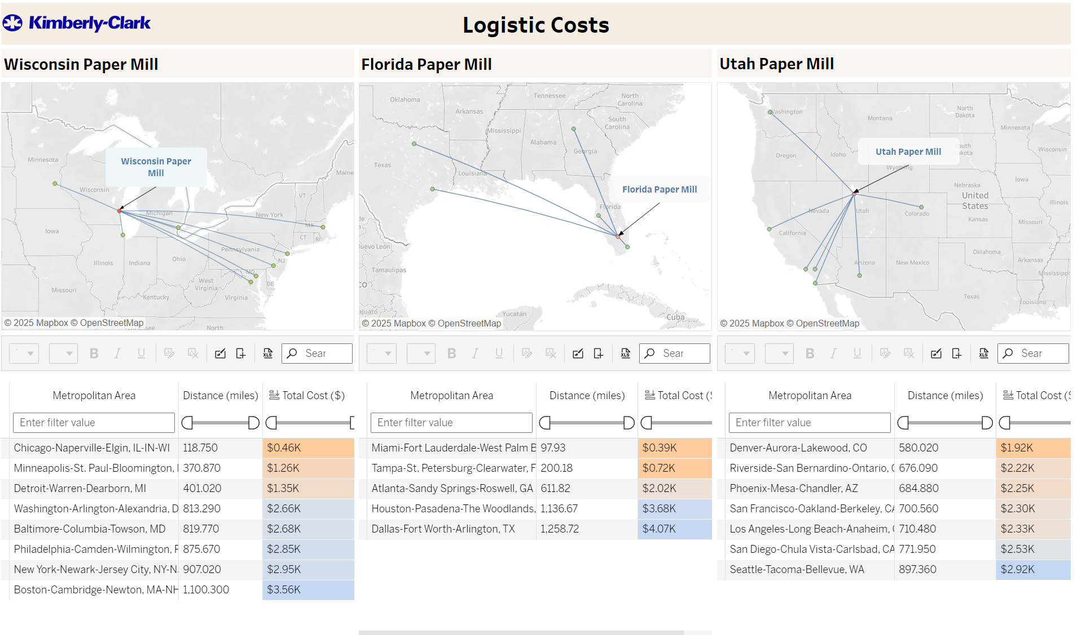
Logistic Dashboard

Slide 35
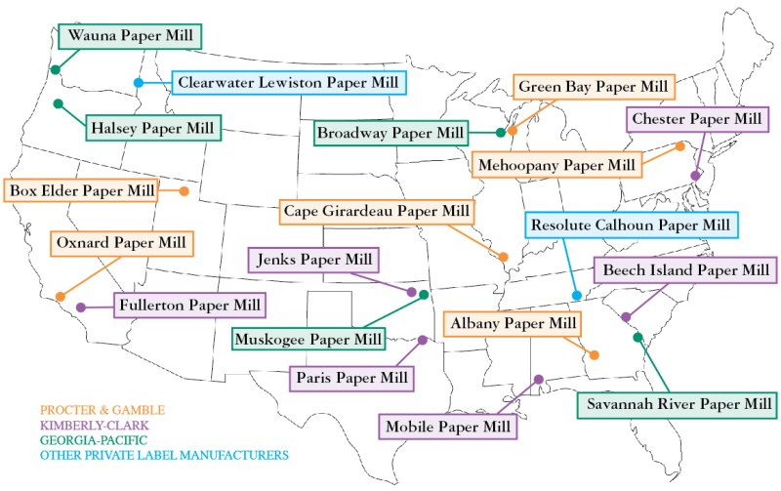

Slide 36
Curveball: Challenge Statement
To provide social, regulatory, and ethical risks associated with site selection. To identify the best locations for the new mills while navigating the hidden complexities ensuring a data-driven, ethical, and sustainable recommendation

Slide 37
Socio-Economic Factors
Factors | Reasons for considerations
Median Household Income | Indicates purchasing power & stability. Also relates to quality of life and cost of living.
Employment Rate | Reflects economic health and availability of skilled/unskilled labor. Critical for hiring.
Population Density | Balances access to market/labor with congestion or rural isolation.
Education Level | Helps in skilled workforce availability and long-term adaptability.
Poverty Rate | High poverty correlates with instability, infrastructure issues.
Age Distribution | Ensures presence of working-age population.
Race Distribution | Encourages diversity; minimal direct effect unless there's data showing economic disparity locally.

Slide 38
Ethical Factors
Factor | Reason for Consideration
Air Quality Index (AQI) | Lower AQI = cleaner air, fewer emissions, healthier community & workers
Water Quality Index (WQI) | Clean water = essential for tissue manufacturing, sustainable discharge
Protected Area % | High protection may limit expansion, bring compliance/regulation issues
Carbon Footprint of Area | Lower footprint = cleaner area, indicates green practices
Renewable Energy Use % | Supports ESG goals, aligns with green production methods
Electricity Cost | Tissue mills are energy intensive; cost directly impacts operating margins

Slide 39
Tax and Regulatory Factors
Factor | Reasons for Consideration
Tax Incentives | Can significantly reduce capital expenditure & operating cost
Zoning | Impacts how quickly the mill can be approved & built
Union Presence | Affects labor flexibility, bargaining, and long-term costs
Wages | Directly impacts long-term operational expenses
Environmental Constraints | Can delay construction, add costs, or prevent approval

Slide 40
Tax and Regulatory Factors
Location | Tax Credit / Incentive | Estimated Benefit
Kane, UT | EDC Tax Rebate up to 30% of new state taxes | $6M–$9M (10 yrs)
Sheboygan, WI | Mfg & Ag Credit (~0.4% effective corp tax rate) | $10M saved over 10 yrs
Glades, FL | QTI Refund ($3K/job), Equipment Tax Exemption | $5M–$8M + infrastructure grants

Slide 41
Final Recommendations
Wisconsin:
good for tax incentives
work force ready
focus sustainability
Utah :
No Impact on sacrificed community
High scope economic development
Florida:
Up serving Underserved community
Resource availability

Slide 42
Thank You

